Slide 1
Human skin detection
By- GARV Jaiswal (Ra2011033010035)
bedanta gautom (ra2011033010048)
Vaibhav jha (ra2011033010058)

Slide 2
Contribution
GARV JAISWAL (RA2011033010035) – Objectives, Limitations and Architecture diagram. BEDANTA GAUTOM (RA2011033010048) – Implementation, Methodology and Calculation.
VAIBHAV JHA (RA2011033010058) – Literature Survey, Result and Analysis.

Slide 3
Problem statement
A reliable human skin detection method that is adaptable to different human skin colors and illumination conditions is essential for better human skin segmentation. Even though different human skin color detection solutions have been successfully applied, they are prone to false skin detection and are not able to cope with the variety of human skin colors across different ethnic.
In this approach we refine the skin model by combining HSV & YCbCr color spaces. The proposed approach reduces computational costs as no training is required and it improves the accuracy of skin detection despite wide variation in ethnicity and illumination.

Slide 4
Societal benefits
Enhanced public safety: Human skin detection can be used in surveillance systems to identify individuals in crowded places, such as airports, train stations, or sports venues. This can help in identifying potential threats or suspicious activities, enhancing public safety and security.
Preventing explicit content dissemination: Skin detection algorithms can be employed to identify explicit or adult content in images or videos, thereby aiding in content moderation. This technology can help prevent the distribution of inappropriate or harmful material, especially on platforms accessible to children and vulnerable individuals.
Support for medical diagnosis: Human skin detection techniques can assist in medical imaging and diagnosis. For instance, in dermatology, these algorithms can be employed to identify and analyze skin conditions, such as lesions, rashes, or melanoma, potentially aiding in early detection and treatment.

Slide 5
Literature survey
S.No | Title | Journal Name | Author | Date of Publication | Highlights
1. | Recent Advances in Deep Learning Techniques for Face Recognition | Department of Computer Science and Engineering, Khulna University of Engineering and Technology, Khulna 9203, Bangladesh | MD. Tahmid Hasan Fuad Awal Ahmed Fime Delowar Sikder MD. Akil Raihan Iftee | July 2021 | Researchers have proposed many deep learning (DL) methods and particularly face recognition (FR) made an enormous leap.
2. | Face Skin Color Detection Method Based on YUV-KL Transform | 2022 4th International Conference on Artificial Intelligence and Advanced Manufacturing (AIAM) | Yiping Chen Fengshan Yuan | March 2023 | The purpose of this paper is to study the method of face skin color detection based on YUV-KL transform.

Slide 6
Literature survey
S.No | Title | Journal Name | Author | Date of Publication | Highlights
3. | A review of human skin detection applications based on image processing | Bulletin of Electrical Engineering and Informatics | Hussein Ali Alnafaakh Rozaida Ghazali Nidhal Khdhair El abbadi | February 2021 | Virtual image processing is the use of a digital computer to manipulate digital images through an algorithm for many applications.
4. | Human Skin Detection Using RGB, HSV and YCbCr Color Models | International Conference on Communication and Signal Processing 2016 (ICCASP 2016) | S. Kolkur D. Kalbande P. Shimpi C. Bapat J. Jatakia | August 2017 | Human Skin detection deals with the recognition of skin-colored pixels and regions in a given image.

Slide 7
INFERENCES
To develop an accurate skin tone detection algorithm, you would need to collect a large dataset of images that cover a wide range of skin tones. The dataset should be diverse and representative of different ethnicities, ages, and genders. Collecting data ethically and with the appropriate consents is of utmost importance.[1][2]
The images in the dataset would need to be preprocessed to remove any background noise, normalize lighting conditions, and crop the images to focus on the face or body parts of interest.[1][2]
Once the images are preprocessed, you would need to extract relevant features from the images. For skin tone detection, color and texture features would be relevant. Some techniques for feature extraction include histogram-based approaches and machine learning-based approaches.[2][4]

Slide 8
INFERENCES
After extracting the features, you can develop an algorithm for skin tone detection. This could be done using traditional image processing techniques or using machine learning models such as convolutional neural networks (CNNs) or support vector machines (SVMs). CNNs have been shown to be highly effective in image classification tasks.[1][3][4]
You would need to test and validate the skin tone detection algorithm on a separate dataset to assess its accuracy and generalization ability. The validation dataset should be representative of the data the algorithm is expected to encounter in the real world.[1][3][4]
Skin tone detection can be a sensitive issue, and the algorithm should be developed with ethical considerations in mind. For example, the algorithm should be designed to avoid perpetuating harmful stereotypes or discriminating against certain groups of people. Additionally, transparency should be maintained regarding the data and the algorithm to avoid any potential biases or discrimination.[2][4]

Slide 9
PROPOSES
The system aims at providing a method which provides more robust and accurate results with minimum computational cost irrespective of various factors such as camera characteristics, ethnicity, hairstyle, makeup, shadows, illumination, motion background colors, also influence skin color appearance.
The suggested method combines HSV color space model image and YCbCr color space model image for automatic human skin detection in color images.
This method reduces computational costs as no training is required and it also displays the output with higher accuracy of skin detection despite wide variation in illumination, ethnicity and Background.
This system also overcomes the effect of illumination depending on the surroundings, individual characteristics varying skin tone with respect to different regions and other factors such as background colors, shadows etc.

Slide 10
Limitation of existing system
Detection of skin color pixels and non skin color pixels and its classification is quite challenging task. In an image the skin color is sensitive to various factors such as camera characteristics, ethnicity, hairstyle, makeup, shadows, illumination, motion background colors, also influence skin color appearance.
Although various human skin color detection solutions have been effectively applied, they prostrate with false skin detection and are not able to cope with the variety of human skin colors across different ethnic. Also, existing methods need high computational cost.
Also, there are many human skin detection methods in the current trend, which uses different color spaces along with various algorithms on the images to overcome all the illuminations for detection of human skin. Such existing methods result in less accuracy, need high computational cost, and more execution time.

Slide 11
objectives
The system aims at providing a method which provides more robust and accurate results with minimum computational cost irrespective of various factors such as camera characteristics, ethnicity, hairstyle, makeup, shadows, illumination, motion background colors, also influence skin color appearance.
The suggested method combines HSV color space model image and YCbCr color space model image for automatic human skin detection in color images.
This method reduces computational costs as no training is required and it also displays the output with higher accuracy of skin detection despite wide variation in illumination, ethnicity and Background.
This system also overcomes the effect of illumination depending on the surroundings, individual characteristics varying skin tone with respect to different regions and other factors such as background colors, shadows etc.

Slide 12
Proposed methodology
Preprocessing:
Convert the input image to a color space that enhances the distinction between skin tones such as YCbCr and HSV.
Thresholding:
Apply a thresholding operation to the preprocessed image to segment potential skin regions.
Set a threshold value based on the color or intensity values that separates skin pixels from non-skin pixels.
Generate a binary image where skin pixels are represented by white and non-skin pixels by black.

Slide 13
Proposed methodology
Connected Component Analysis:
Perform connected component analysis on the thresholded image to identify connected regions.
Assign a unique label or identifier to each connected component.
Analyze the properties of each component, such as its size, shape, and location.
Component Filtering:
Filter the connected components based on certain criteria to identify human skin regions.
Exclude small components that are likely noise or artifacts.
Retain larger components that represent potential human skin regions.

Slide 14
Proposed methodology
Post-processing:
Apply post-processing operations to refine the detected skin regions.
Perform morphological operations to smooth the boundaries and fill small gaps in the regions.
Output Visualization:
Visualize the detected skin regions by overlaying them on the original image or generating a binary mask.
Generate a final binary mask where skin pixels are represented by white and non-skin pixels by black.

Slide 15
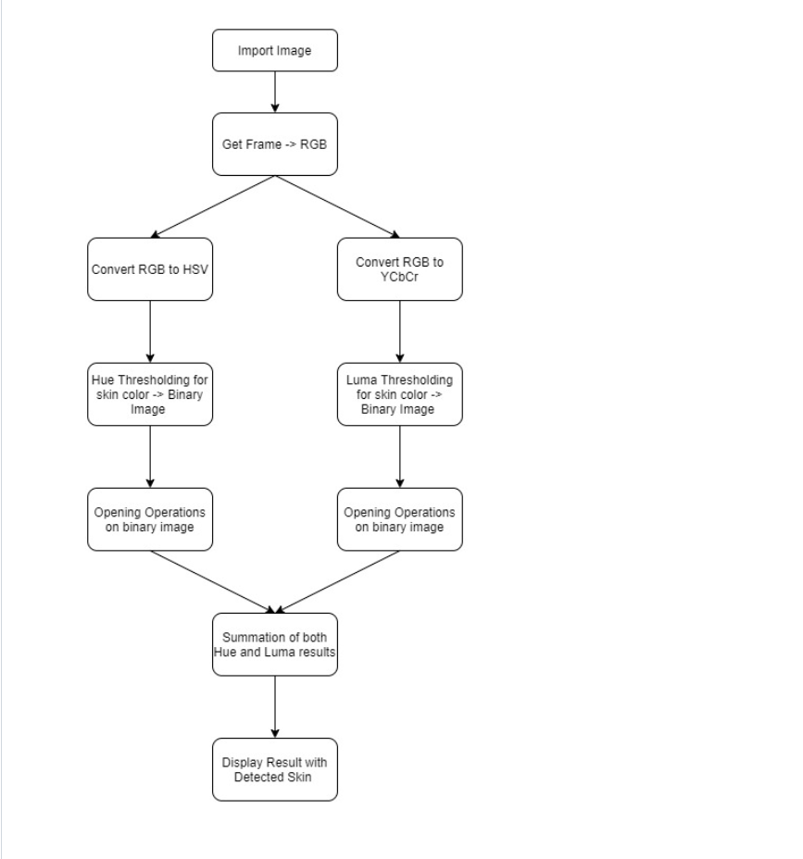
Architecture diagram

Slide 16
Modules description
Preprocessing: The color space conversion module converts the input data from the RGB color space to HSV and YCbCr. This conversion helps in isolating skin color information.
Thresholding: Apply a thresholding operation to the preprocessed image to segment the skin regions. This step involves setting a threshold value to differentiate skin pixels from non-skin pixels based on color or intensity values. Pixels above the threshold are considered potential skin pixels.
Connected Component Analysis: Perform connected component analysis on the thresholded image. This analysis groups neighboring pixels with similar properties (in this case, skin color) into connected components or regions. The algorithm assigns a unique label or identifier to each connected component.

Slide 17
Modules description
Component Filtering: Filter the connected components based on their characteristics to identify the human skin regions. Various criteria can be considered, such as the component's size, shape, or location.
Post-processing: Apply post-processing operations to refine the detected skin regions. This can include morphological operations like erosion or dilation to smooth the boundaries or fill small gaps in the regions. These steps help improve the accuracy and completeness of the final skin detection results.
Output Visualization: Finally, visualize the detected skin regions by overlaying them on the original image or generating a binary mask where skin pixels are represented by white and non-skin pixels by black. This visualization helps in evaluating the effectiveness of the skin detection algorithm.

Slide 18
Dataset details
HGR (Hand Gesture Recognition) Image Database URL : http://sun.aei.polsl.pl/~mkawulok/gestures/
SFA (A Human Skin Image Database based on FERET and AR Facial Images) Image Database URL : http://www.sel.eesc.usp.br/sfa/

Slide 19
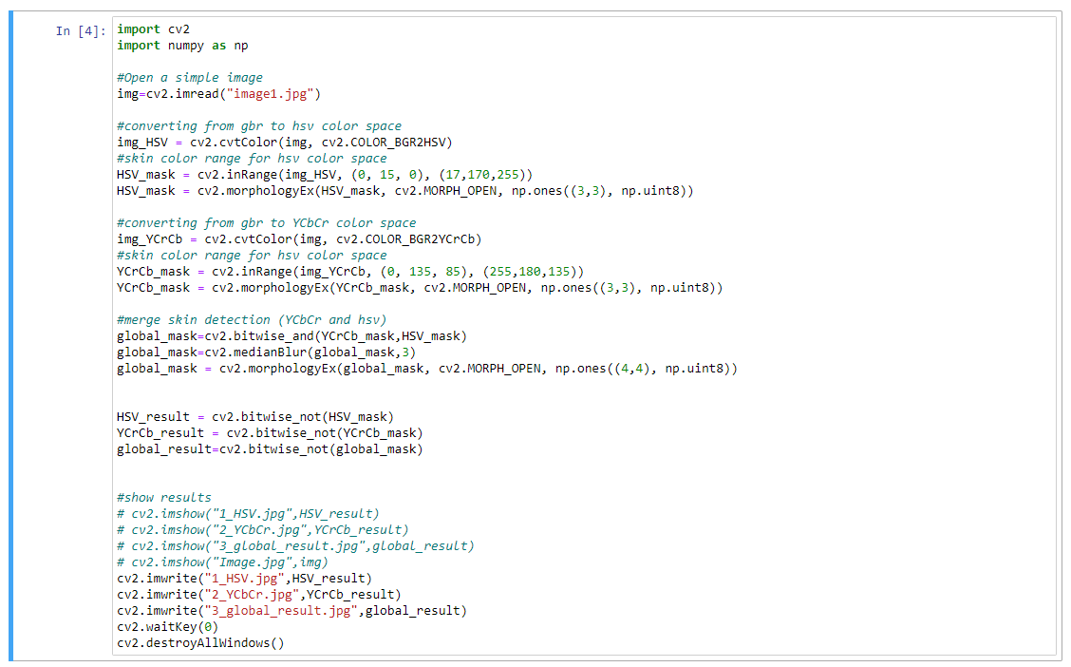
IMPLEMENTATION WITH SCREENSHOTS
Here is the code for the implementation of Human Skin Detection system using connected component algorithm:

Slide 20
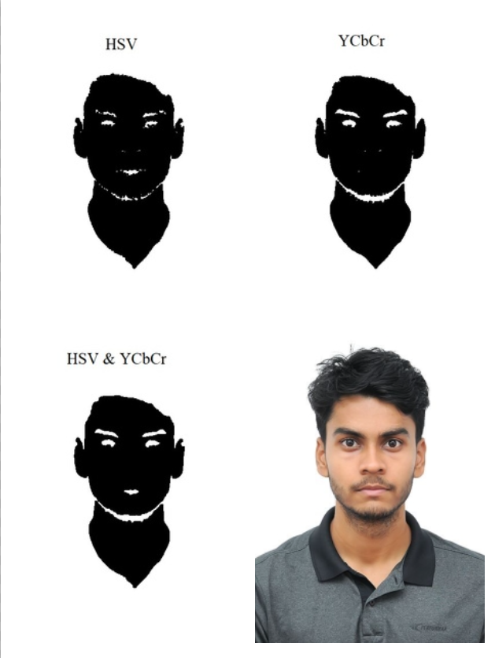
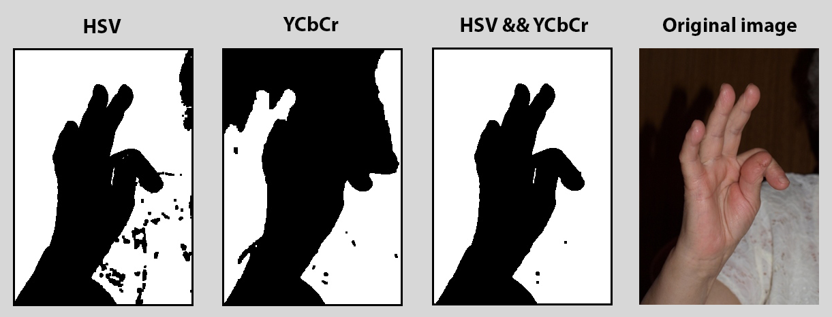
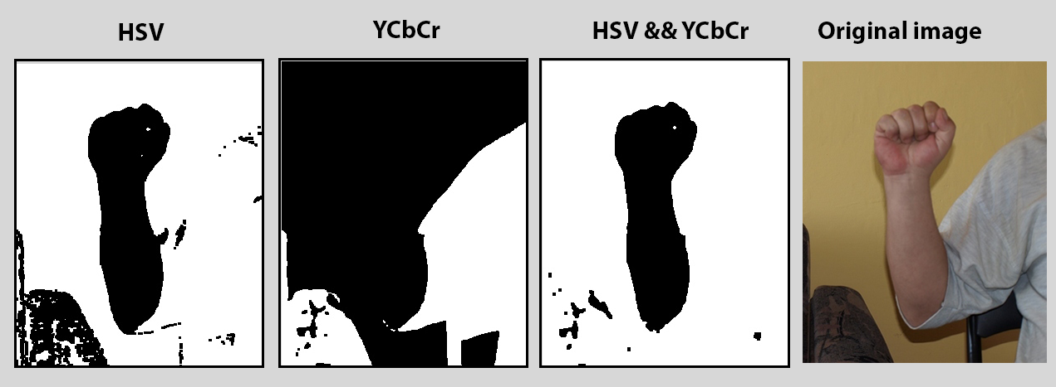
IMPLEMENTATION WITH SCREENSHOTS
In the following images you will see the skin detection results of each color space threshold, and the result of their association.

Slide 21
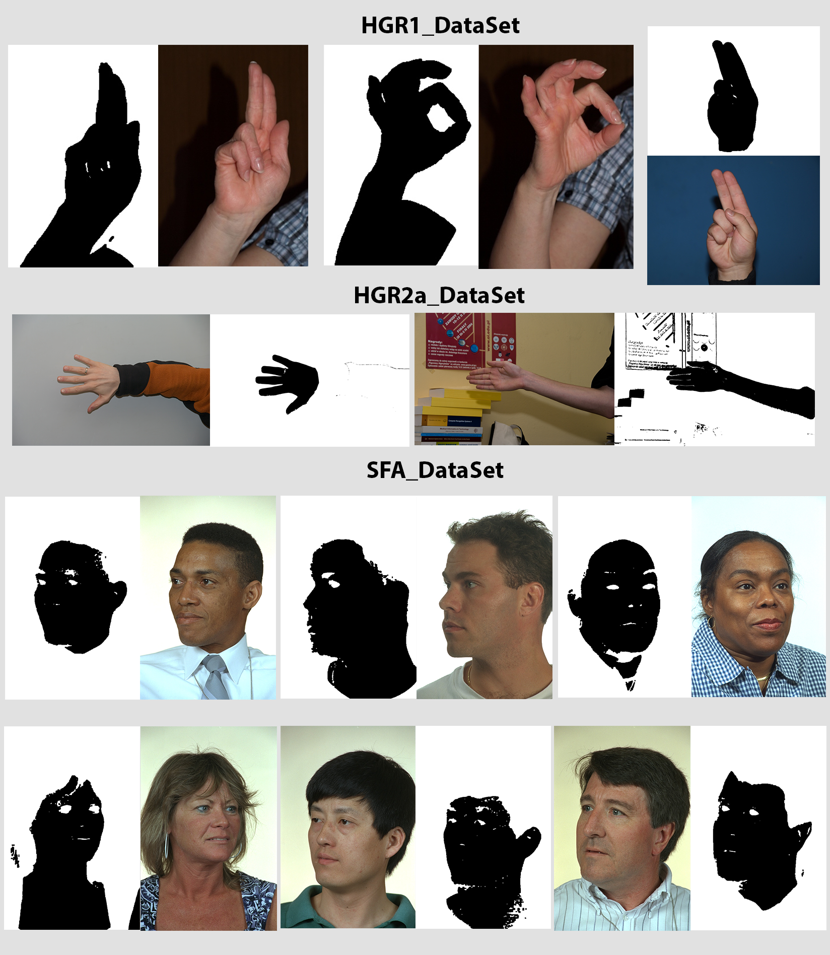
IMPLEMENTATION WITH SCREENSHOTS
In the following images you will see the skin detection results of this method using images from two databases SFA and HGR.

Slide 22
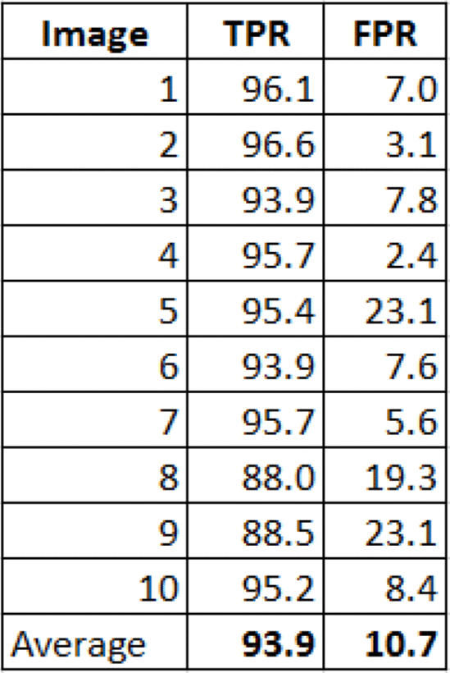
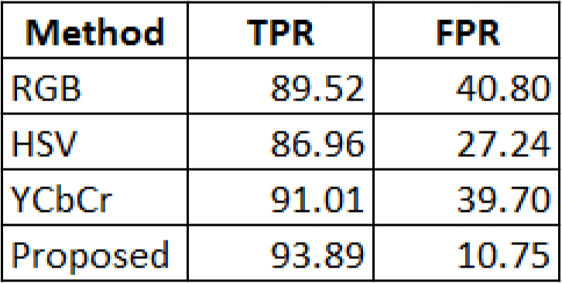
RESULTS TABLE
In the following images you will see the skin detection results of this method using images from two databases. The True Positif Rate (TPR) states the percentage of skin color is detected as skin color, whereas the False Positif Rate mean the percentage of skin color is detected as non skin color.

Slide 23
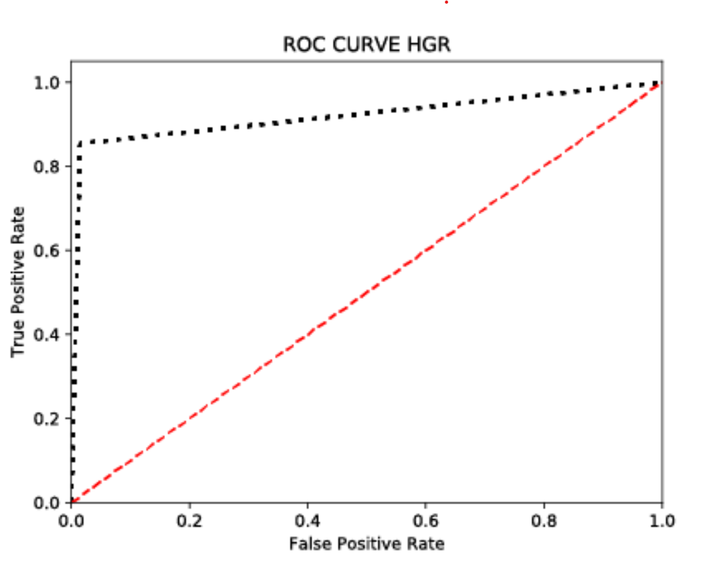
Analysis Graph
We have tested the performance of this method using images from two different database :
HGR (Hand Gesture Recognition) Image Database
URL : http://sun.aei.polsl.pl/~mkawulok/gestures/

Slide 24
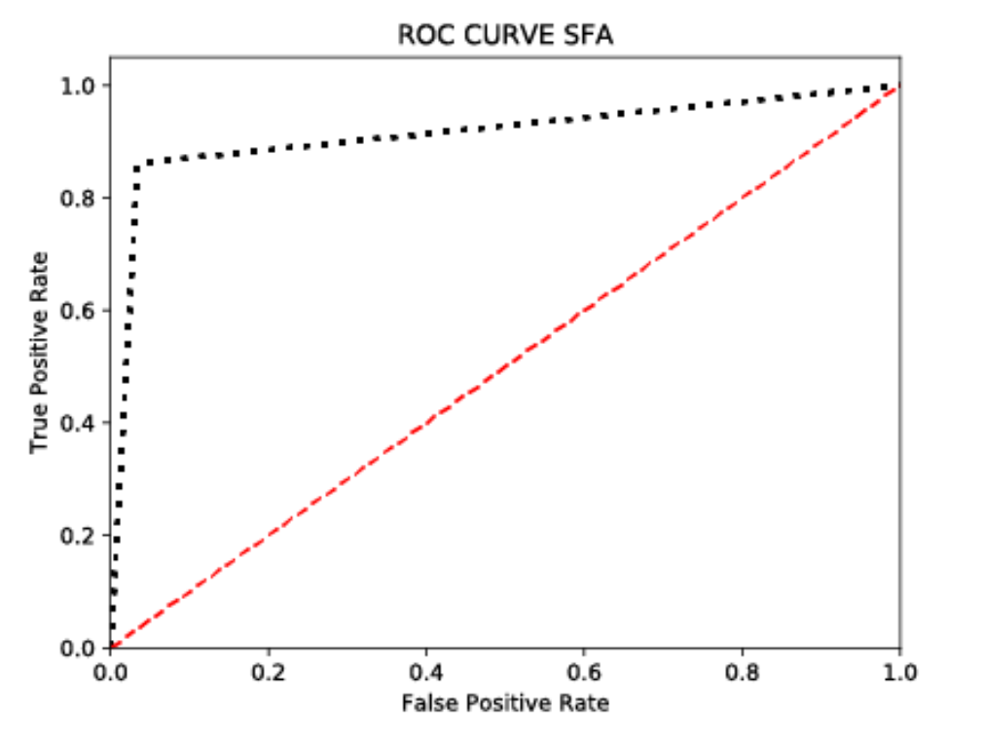
Analysis graph
SFA (A Human Skin Image Database based on FERET and AR Facial Images) Image Database
URL : http://www.sel.eesc.usp.br/sfa/

Slide 25
GITHUB LINK
https://github.com/AIproject-skindetection/AI-Project-Skindetection

Slide 26
REFERENCES
https://www.researchgate.net/publication/350326846
https://ieeexplore.ieee.org/document/10071499
https://ieeexplore.ieee.org/document/7005726
https://www.researchgate.net/publication/344323908
https://arxiv.org/abs/1708.02694

